Slide 1
Introduction to Computer Vision

Slide 2
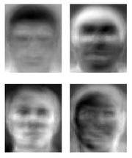
Ridiculously brief history of computer vision
1966: Minsky assigns computer vision as an undergrad summer project
1960’s: interpretation of synthetic worlds
1970’s: some progress on interpreting selected images
1980’s: ANNs come and go; shift toward geometry and increased mathematical rigor
1990’s: face recognition; statistical analysis in vogue
2000’s: broader recognition; large annotated datasets available; video processing starts
Guzman ‘68
Ohta Kanade ‘78
Turk and Pentland ‘91
Notes:
2

Slide 3
Computer Vision and Nearby Fields
Computer Graphics: Models to Images
Comp. Photography: Images to Images
Computer Vision: Images to Models

Slide 4
What is Computer Vision?
Image Understanding (AI, behavior)
A sensor modality for robotics
Computer emulation of human vision
Inverse of Computer Graphics
Computer
vision
World
model
World
model
Computer
graphics

Slide 5
Intersection of Vision and Graphics
rendering
shape estimation
modeling
shape
light
motion
optics
images
IP
modeling
shape
light
motion
optics
images
IP
surface design
motion estimation
animation
recognition
2D modeling
user-interfaces
Computer Graphics
Computer Vision

Slide 6
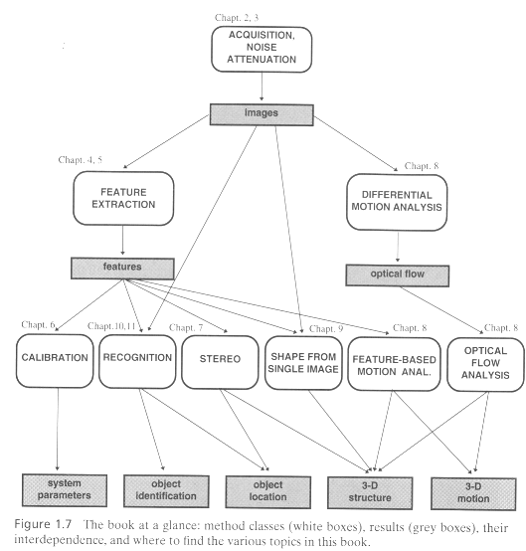
Computer Vision [Trucco&Verri’98]

Slide 7
Image-Based Modeling
image processing
graphics
Images (2D)
Geometry (3D) shape
+
Photometry appearance
vision
3 Image processing
2.1 Geometric image formation
2.2 Photometric image formation
4 Feature extraction
5 Camera calibration
7 Image
alignment
6 Structure from motion
8 Mosaics
9 Stereo correspondence
11 Model-based reconstruction
12 Photometric recovery
14 Image-based rendering

Slide 8
Applications
Geometric reconstruction: modeling, forensics, special effects (ILM, RealVis,2D3)
Image and video editing (Avid, Adobe)
Webcasting and Indexing Digital Video (Virage)
Scientific / medical applications (GE)

Slide 9
Applications
Tracking and surveillance (Sarnoff)
Fingerprint recognition (Digital Persona)
Biometrics / iris scans (Iridian Technologies)
Vehicle safety (MobilEye)
Drowning people (VisionIQ Inc)
Optical motion capture (Vicon)

Slide 10
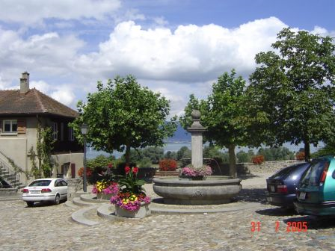
Computer Vision
Make computers understand images and video.
What kind of scene?
Where are the cars?
How far is the building?
…

Slide 11
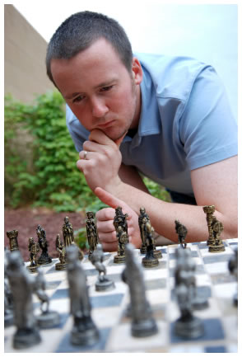
Vision is really hard?
Vision is an amazing feat of natural intelligence
Visual cortex occupies about 50% of Macaque brain
More human brain devoted to vision than anything else
Is that a queen or a bishop?

Slide 12
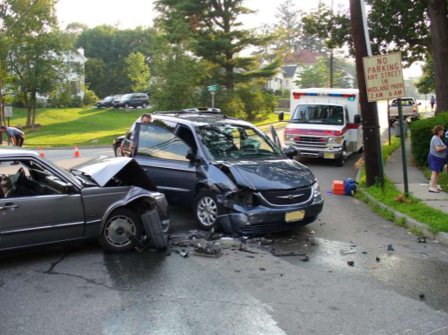
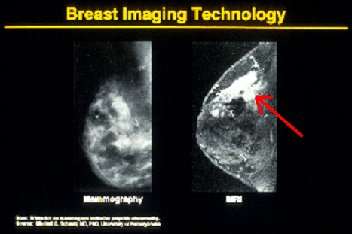


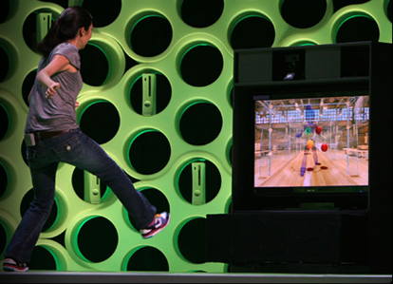

Why computer vision matters
Safety
Health
Security
Comfort
Fun
Access

Slide 13
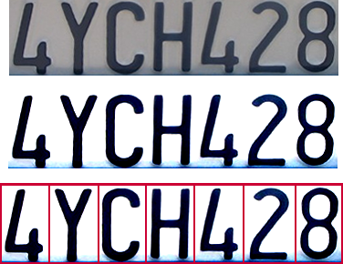

Optical character recognition (OCR)
Technology to convert scanned docs to text
If you have a scanner, it probably came with OCR software
Digit recognition, AT&T labs
http://www.research.att.com/~yann/
License plate readers
http://en.wikipedia.org/wiki/Automatic_number_plate_recognition
Notes:
13

Slide 14
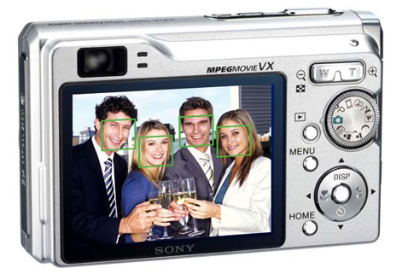
Face detection
Many new digital cameras now detect faces
Canon, Sony, Fuji, …
Notes:
14
Why would this be useful? Main reason is focus. Also enables “smart” cropping.

Slide 15
Smile detection
Sony Cyber-shot® T70 Digital Still Camera
Notes:
15

Slide 16

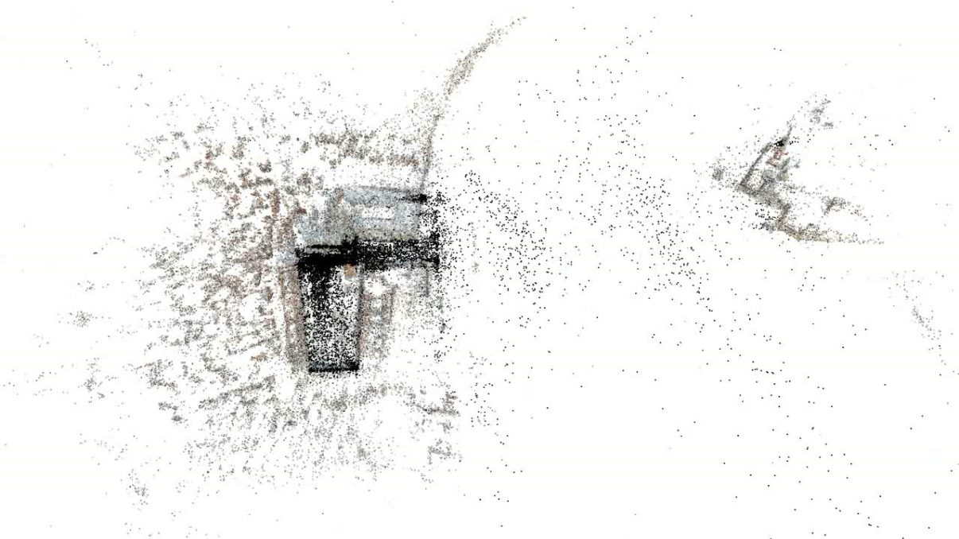
3D from thousands of images
Notes:
16

Slide 17

Object recognition (in supermarkets)
LaneHawk by EvolutionRobotics
“A smart camera is flush-mounted in the checkout lane, continuously watching for items. When an item is detected and recognized, the cashier verifies the quantity of items that were found under the basket, and continues to close the transaction. The item can remain under the basket, and with LaneHawk,you are assured to get paid for it… “
Notes:
17

Slide 18
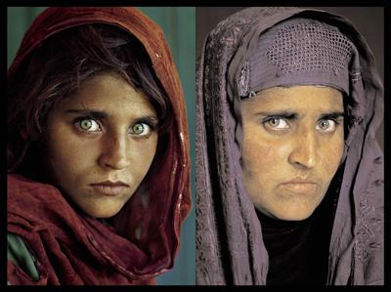
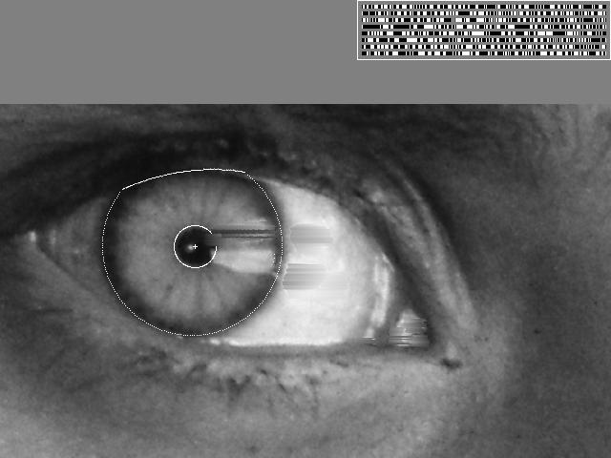
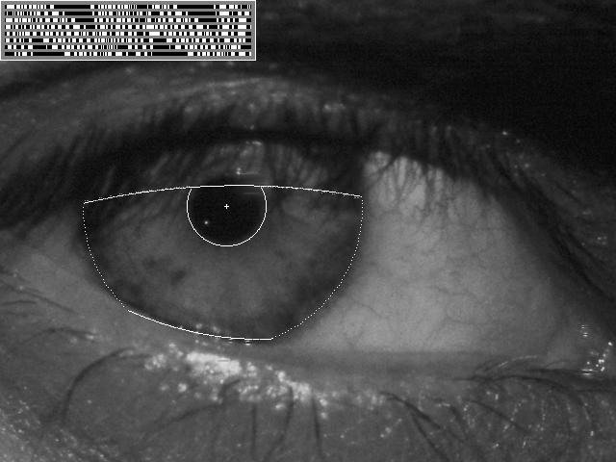
Vision-based biometrics
“How the Afghan Girl was Identified by Her Iris Patterns” Read the story
wikipedia
Notes:
18
Age 12, Age 30

Slide 19


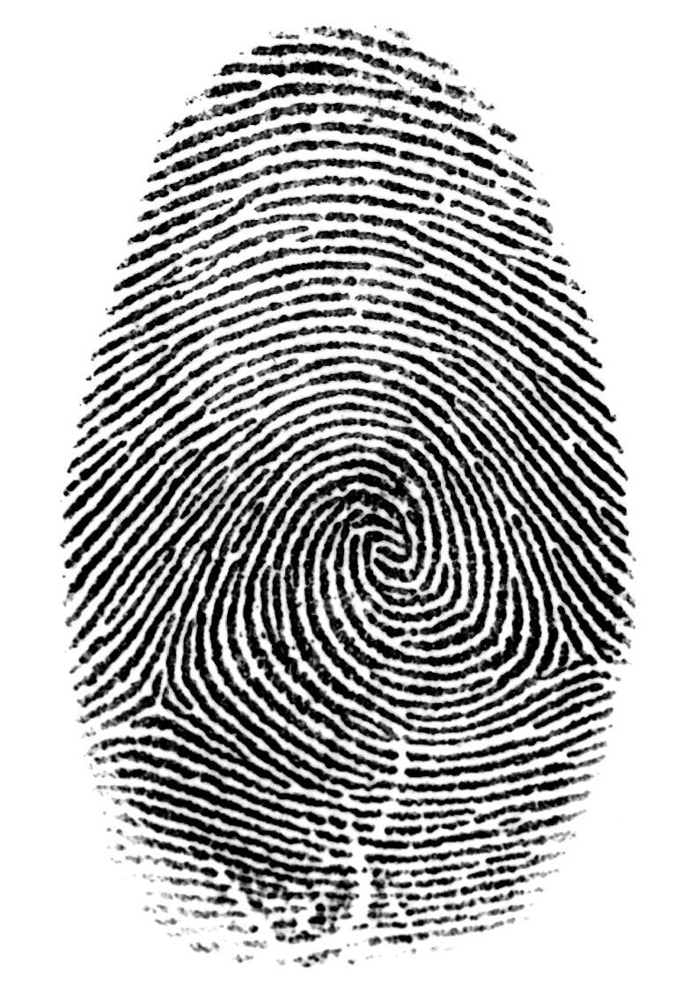

Login without a password…
Fingerprint scanners on many new laptops, other devices
Face recognition systems now beginning to appear more widely http://www.sensiblevision.com/
Notes:
19

Slide 20
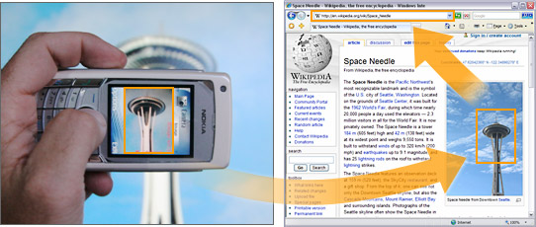
Object recognition (in mobile phones)
Point & Find, Nokia
Google Goggles
Notes:
20

Slide 21
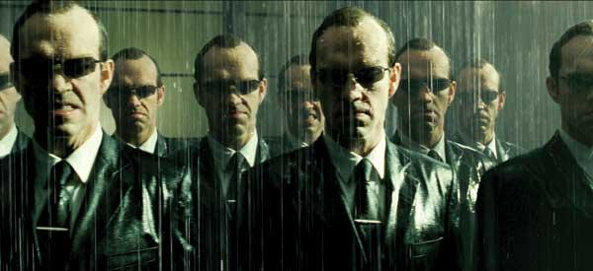
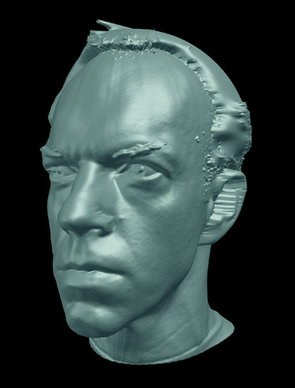
Special effects: shape capture
The Matrix movies, ESC Entertainment, XYZRGB, NRC
Notes:
21

Slide 22

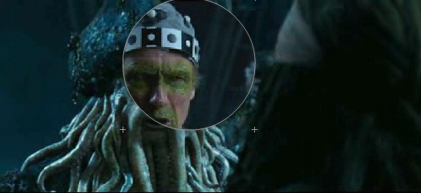
Special effects: motion capture
Pirates of the Carribean, Industrial Light and Magic
Notes:
22

Slide 23
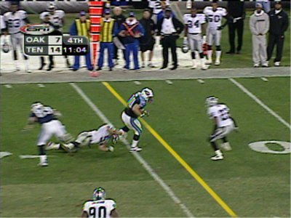
Sports
Sportvision first down line
Nice explanation on www.howstuffworks.com
http://www.sportvision.com/video.html
Notes:
23

Slide 24
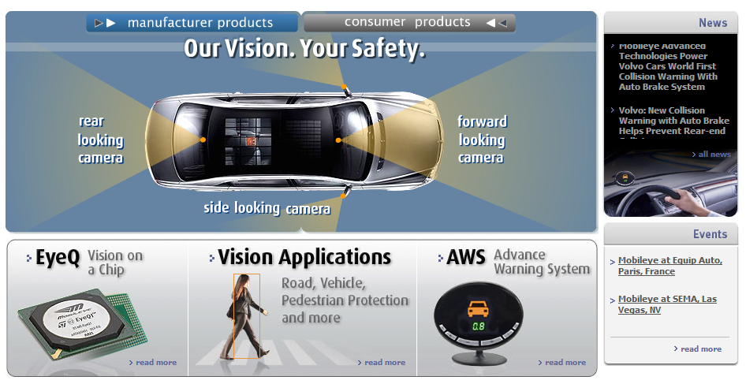
Smart cars
Slide content courtesy of Amnon Shashua
Mobileye
Vision systems currently in high-end BMW, GM, Volvo models
By 2010: 70% of car manufacturers.
Notes:
24

Slide 25
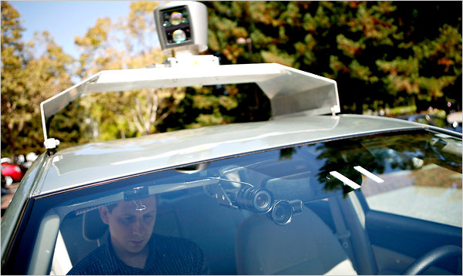
Google cars
http://www.nytimes.com/2010/10/10/science/10google.html?ref=artificialintelligence

Slide 26

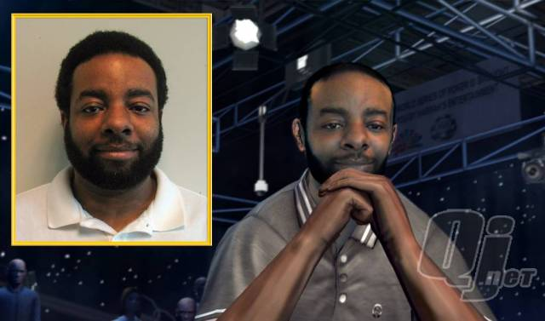
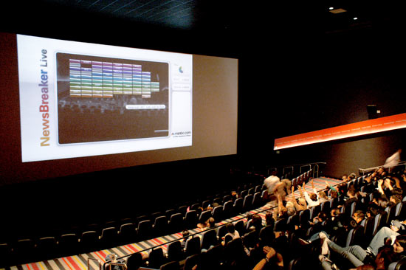
Vision-based interaction (and games)
Digimask: put your face on a 3D avatar.
Nintendo Wii has camera-based IR tracking built in. See Lee’s work at CMU on clever tricks on using it to create a multi-touch display!
“Game turns moviegoers into Human Joysticks”, CNET
Camera tracking a crowd, based on this work.
Notes:
26

Slide 27
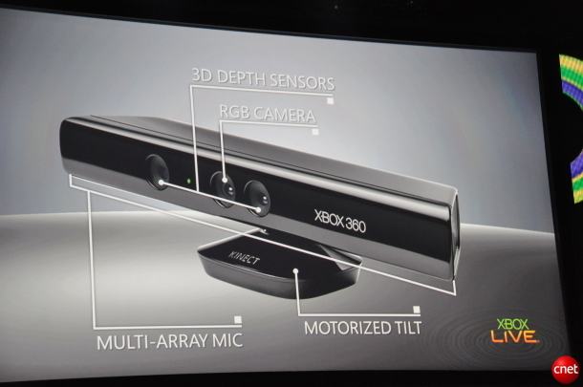

Interactive Games: Kinect
Object Recognition: http://www.youtube.com/watch?feature=iv&v=fQ59dXOo63o
Mario: http://www.youtube.com/watch?v=8CTJL5lUjHg
3D: http://www.youtube.com/watch?v=7QrnwoO1-8A
Robot: http://www.youtube.com/watch?v=w8BmgtMKFbY

Slide 28
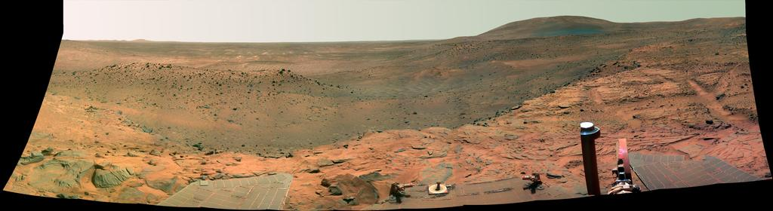
Vision in space
NASA'S Mars Exploration Rover Spirit captured this westward view from atop a low plateau where Spirit spent the closing months of 2007.
Vision systems (JPL) used for several tasks
Panorama stitching
3D terrain modeling
Obstacle detection, position tracking
For more, read “Computer Vision on Mars” by Matthies et al.
Notes:
28

Slide 29
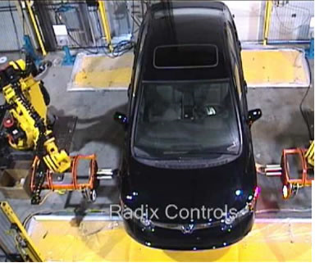
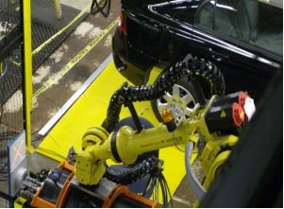
Industrial robots
Vision-guided robots position nut runners on wheels
Notes:
29

Slide 30

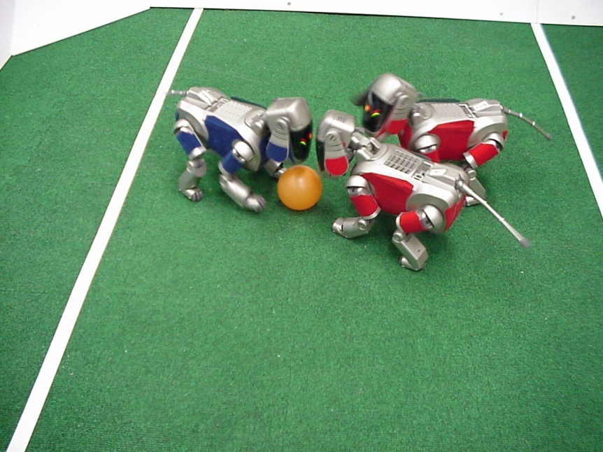
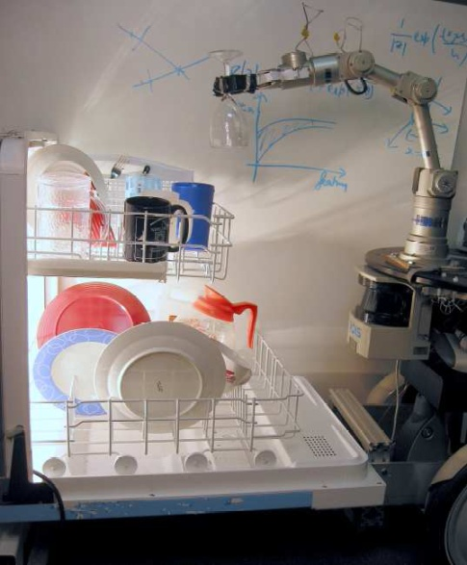
Mobile robots
NASA’s Mars Spirit Rover
http://en.wikipedia.org/wiki/Spirit_rover
http://www.robocup.org/
Saxena et al. 2008
STAIR at Stanford
Notes:
30

Slide 31
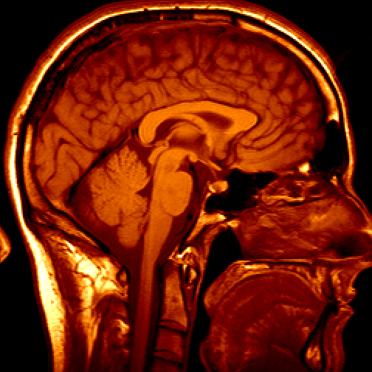
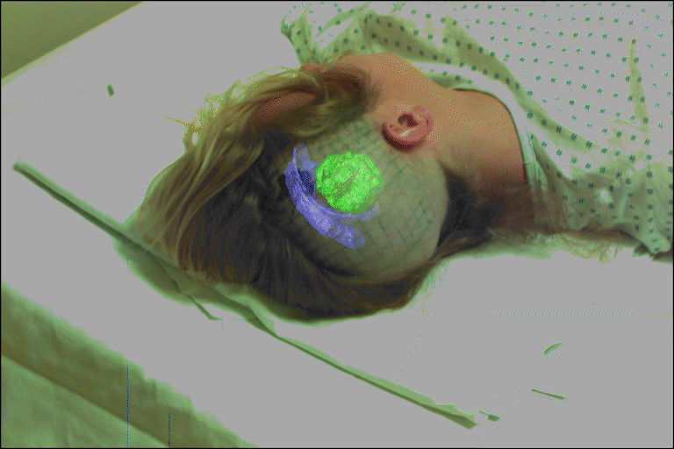
Medical imaging
3D imaging
MRI, CT
Image guided surgery
Grimson et al., MIT
Notes:
31

Slide 32
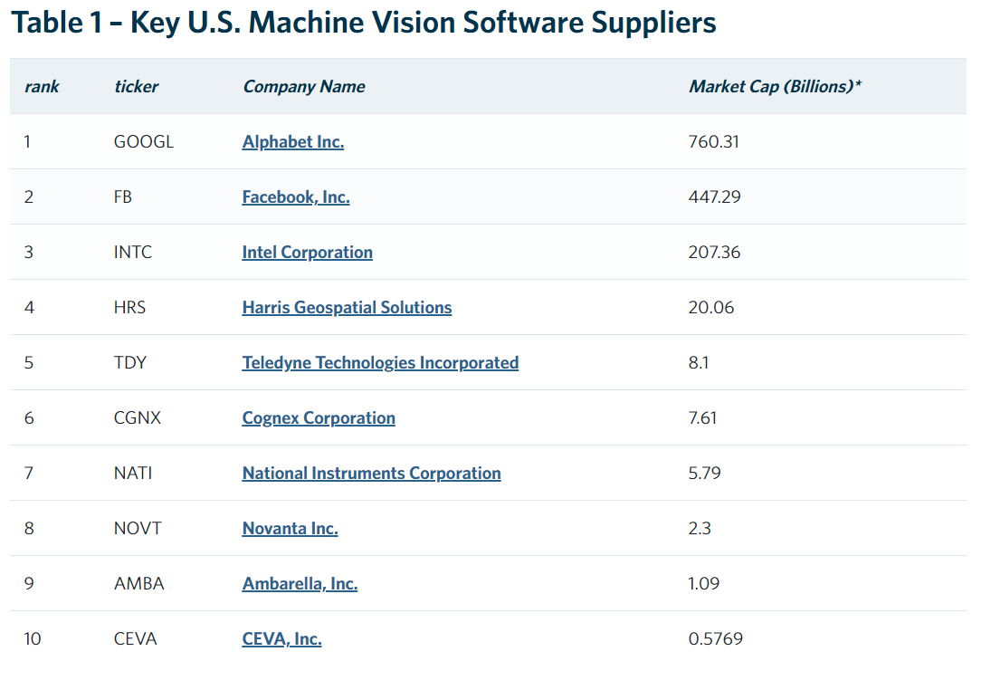

Slide 33
Now, What is Computer Vision?
Computer vision is a field of artificial intelligence that trains computers to interpret and understand the visual world.
Computer vision is an interdisciplinary scientific field that deals with how computers can gain high-level understanding from digital images or videos.

